Slide 1
ECII/ECSI 3206: Artificial Intelligence [and expert systems] Topic 7: Expert Systems
By: Edgar Otieno

Slide 2
Introduction to Expert Systems
Expert System-IS which mimics /copies human intelligence and expertise in solving problems
A system that users human knowledge captured in a computer to solve
problems that ordinarily require human expertise.” – Efraim Turban and Jay Aron- son

Slide 3
Expert Systems VS. Conventional Programs
Expert systems simulate human reasoning about a problem domain, while conventional programs simulate the domain itself.
E.S perform reasoning over representations of human knowledge, numerical calculations and data retrieval while conventional programs perform numeri- cal calculations and data retrieval.
E.S solve problems using heuristic or approximate methods that do not guar- antee success, while conventional programs provide algorithmic solutions.

Slide 4
Expert Systems VS. Other AI Programs
E.S deal with problems that require human expertise, while most AI programs focus on abstract mathematical problems or simplified versions of real problems.
E.S must be fast and reliable in order to be useful, most AI programs do not run very fast and are programs rather than supported software.
Expert systems must be able to explain and justify their solutions, other AI programs do not have to meet this requirement because their users are the developers.

Slide 5
Methods of Reasoning Used by E.S
Inductive Reasoning: Use case based reasoning(analogy) and rule based reasoning(K.B+Facts +I.E) to move from specific to general
Deductive reasoning: Use proposition and predicate calculus to move from general to specific

Slide 6
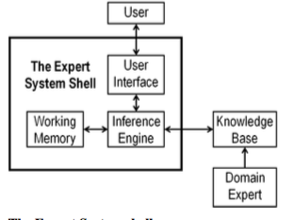
Components of an Expert System

Slide 7
The Expert System shell:
A specialized software tool that is used to develop an expert system. it is made up of the following three components :
The User Interface: It provides means for the non-expert to interact with the knowledge contained in the knowledge base.
The Inference Engine: This is the core of the expert system. It determines how the rules in the knowledge base are processed. The inference engine can be backward chaining, forward chaining or both.
The Working Memory: An area of memory containing
– Observed facts.
– New facts deduced from observed facts.

Slide 8
1. User
2. User interface/Blackboard:point of interaction between the User and E.S. It is usually a NLP interface.
3. Working memory: Where computations Occur
4. Domain Expert: Specialists who contribute knowledge to be captured in the K.B

Slide 9
An expert must:
Be able to perform a task;
Know how to perform the task;
Be able to explain how they perform the task;
Have the time to explain how they perform the task;
Be motivated to cooperate in the enterprise.

Slide 10
5. Knowledge Base: It contains domain specific rules. Contains both factual and heuristic knowledge.
The types of knowledge contained may be:
Factual[knowledge from experts]
Heuristic[ability to evaluate and make some informed guess]
Shallow[knowledge for specific situations]
Deep [knowledge for different tasks/situations]

Slide 11
Knowledge engineer: They provide information For the K.B.. They acquire/ extract information for the K.B from human experts or documents and convert it into a form that can be manipulated by the E.S. usually in the form of If….ELSE rule.
Knowledge acquisition as: “the transfer and trans- formation of potential problem-solving expertise from some knowledge source to a program.”
Knowledge representation may be in the form of rules, propositions, predicates, semantic nets ,frames etc. This knowledge can be used for learning or reasoning.

Slide 12
The difficulties in knowledge acquisition are:
– Many facts and principles cannot be easily represented as mathematical theory or as a deterministic model.
– Human expertise is usually set in the context of commonsense knowl- edge.

Slide 13
5. Inference Engine : Component which uses rules to deduce correct conclusions/solutions.
For K.B, E.S, the Inference Engine acquires and manipulates knowledge from K.B
For Rule based E.S, it applies rule repeatedly to facts from earlier rule applications and adds new knowledge to the K.B while perfoming conflict resolution among the rules if any occurs.
I.E has an explanation facility which gives reason as to why the E.S arrived at a certain conclusion

Slide 14
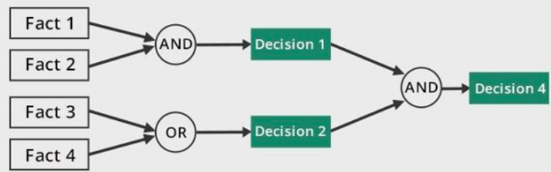
Techniques used by IE
Forward chaining: It considers a chain of conditions to derive a particular outcome/action.(what can happen)
It is data driven
It uses BFS

Slide 15
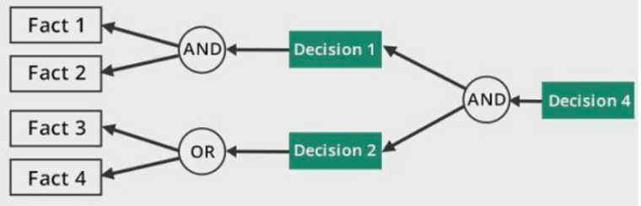
Backward Chaining: it considers what has already happened and tries to find out why it happened(what conditions caused it)
It is goal driven
It uses DFS

Slide 16
Applications of E.S [domain basis]
Medical domain[diagnostics e.g MYCIN]
Monitoring system[pipeline monitoring]
Control [Interpreting, predicting, repairing, and monitoring system behaviors]
Finance Prediction [stock markets, fraud analysis]
Design[Car design, House design]

Slide 17
General steps of Developing an E.S
Id problem domain
Design E.S
Develop prototype E.S
Test and refine Prototype E.S
Develop Complete E.S
Maintain E.S

Slide 18
E.S development Environments
This defines tools that include the hardware and Software used to come up with the E.S e.g
Workstations/Expert System shells
AI toolkits
Large Databases
High level Symbolic programming language[prolog/lisp/python]

Slide 19
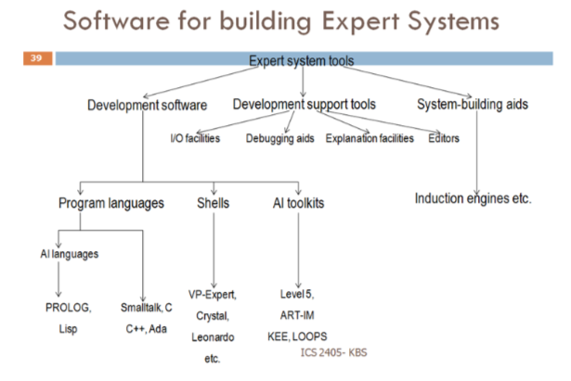

Slide 20
Advantages of E.S
Cheaper-Cheaper than having more experts
Faster
More accurate
Reduced risk to humans in hazardous environments
Multiple Experts Knowledge from multiple experts can be combined
Lack bias
Can work with incomplete or uncertain data Will be able to produce an answer, but it may not be certain
Versatile
Easily available[easy to mass produce]

Slide 21
Disadvantages of E.S
Difficulties of acquiring new knowledge
Are domain specific
Difficulty of independently verifying experts conclusions.
High initial development costs
Loss of jobs for humans

